Slide 1




Collective Classification Algorithms in Identifying Intrinsically Disordered Proteins within Protein-Protein Interaction Networks
2nd ML4NGP MEETING ON MACHINE LEARNING AND NON-GLOBULAR PROTEINS
May 14 - 17, 2024 – Thessaloniki, Greece
Milana Grbić¹, Nenad Vilendečić ¹, Milan Predojević ¹, & Dragan Matić¹
¹Faculty of Natural Science and Mathematics, University of Banja Luka

Slide 2
Introduction
Traditional methods used for IDP classification?
Integrating data from PPI networks?
In this research?

Slide 3
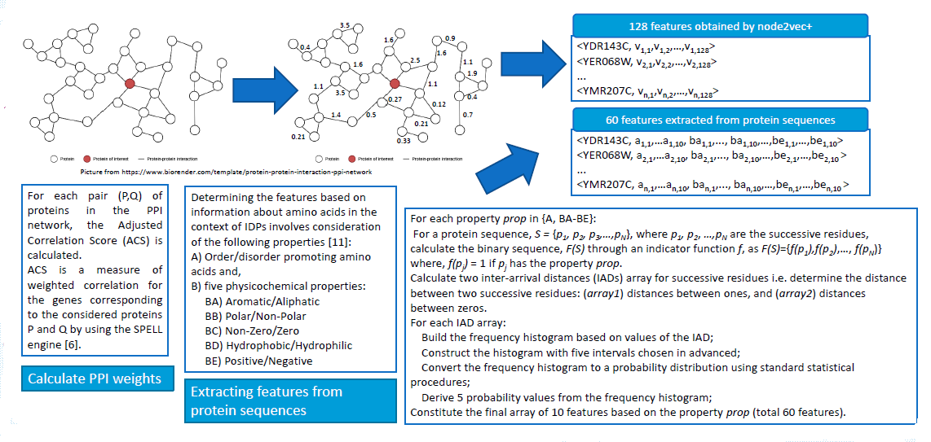
Methodology - Data preparation

Slide 4
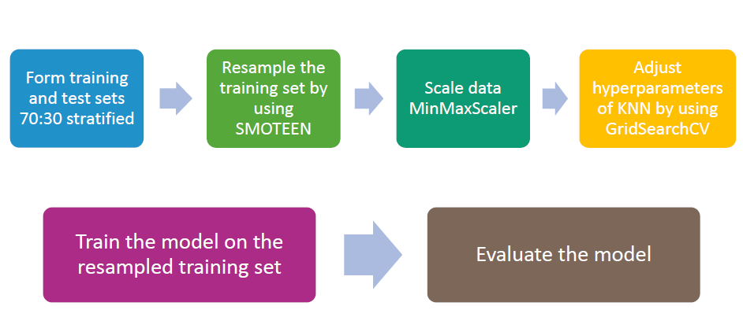
Methodology - Data classification

Slide 5
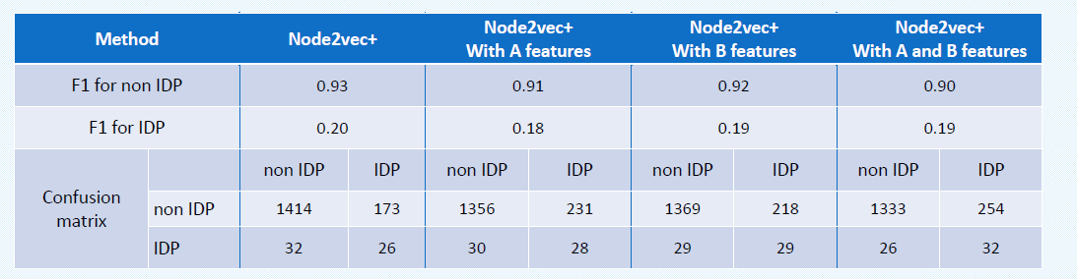
Results

Slide 6
Thank you!
Conclusion?
Future work?
Poster session I → Poster F05!

